Slide 1

While you wait for our presentation to begin, please think of a PASSWORD for your SPS District Accounts:
Must contain 15 characters
Must contain a combination of upper- and lower-case letters
Must contain a number
Must contain a special character
Cannot contain your name
Cannot contain your birthdate

Slide 2

OUR MISSION
Every SPS student engages in joyful and challenging learning experiences throughout their educational journey that prepare them to become lifelong learners and graduate with the knowledge, skills, habits, agency, and community connections they need to pursue their passions and desired post-secondary opportunities.
SPS PROMISE
Every SPS student has a dream, access, and opportunity for a happy and successful future.
Notes:
Welcome slide

Slide 3
Strategic Plan 2022-28
We worked with parents, families, staff, students, and the larger Spokane community to develop this strategic plan, which will guide and inform our work for the next six years.
To ensure we are meeting our commitment to creating a collaborative learning community where every student and every staff member knows that they belong, we outlined these guiding principles:
Equity
Being student-centered
Inclusion
Innovation
Trust and collaboration

Slide 4
Introductions
Bethany Fields
  Classified Substitute Application & Selection Specialist
  BethanyF@spokaneschools.org
  (509) 354-7286
Maya Bybee
Substitute Application & Selection Specialist
MayaB@spokaneschools.org
(509) 354-5953
Shelly Sines
  Substitute Services Manager
  MichelleSi@spokaneschools.org
  (509) 354-7230
Substitute HELP Desk
  (509) 354-7343 OR subdesk@spokaneschools.org

Slide 5
Appropriate Behaviors
It’s the law!

Slide 6
Mandatory Reporters of Suspected Child Abuse (Procedure 3421; RCW 26.44.030)
When any professional school personnel has reasonable cause to believe that a child has suffered abuse or neglect, a report shall be made to the proper Law Enforcement Agency or to Child Protective Services (CPS) with 48 hours.
Be sure to notify your building administrator and counselor.
Be sure you know your building’s process for making the report(s).
Be sure you document:
  Date
  Time
  Report Number
Contact information:
  CPS – (509) 363-3333
  Crime Check – (509) 456-2233
Click here to access the Professional Code of Conduct
Notes:
9 & 10 are the same slide???

Slide 7
    Maintaining Professional Staff/Student Boundaries (Pol/Pro 5253)
    The board expects all district staff to maintain the highest professional standards when they interact with students. District staff are required to maintain an atmosphere conducive to learning by constantly maintaining professional boundaries. See examples below.
Being alone with an individual student out of the view of others;
Inviting or allowing individual students to visit the adult’s home;
Visiting a student’s home;
Sending or soliciting email, text messages or other electronic communications to the student, except when the communication relates to school business, and the building administrator or supervisor has consented to such communications; and/or
Social networking with students for non-educational purposes.
RCW26.44.020: Abuse or Neglect means sexual abuse, sexual exploitation, or injury of a child by any person under circumstances which causes harm to the child’s health, welfare, or safety or the negligent treatment or maltreatment of a child by a person responsible for or providing care to the child.
District Policy 2022: Electronic Resources and Internet Safety​
This policy covers the use of electronic resources and appropriate online behavior.

Slide 8
Harassment, Intimidation & Bullying: (Policy 3207)
The district is committed to a safe and civil educational environment for all students that is free from harassment, intimidation, or bullying. As defined in legislation, “Harassment, intimidation, or bullying” means any intentional, electronic, or written, verbal, or physical act, including but not limited to, one shown to be motivated by race, color, religion, ancestry, national origin, gender, sexual orientation including gender expression or identity, mental, physical, or sensory handicap, or other distinguishing characteristics, when the act:
  Physically harms a student or damages the student’s property;
  Has the effect of interfering with a student’s education;
  Is so severe, persistent, or pervasive that it creates an intimidating or threatening educational environment; or
  Has the effect of disrupting the orderly operation of the school.
  Other distinguishing characteristics” can include but are not limited to physical appearance, clothing or other apparel, socioeconomic status, and weight.
  Any school staff who observes, overhears, or otherwise witnesses harassment, intimidation or bullying or to whom such actions have been reported must take prompt and appropriate action to stop the harassment, intimidation, or bullying and to prevent its reoccurrence.
Allegations indicating a potential violation of procedure must be reported to your Supervisor and District Compliance Officer (Melanie Smith)

Slide 9
Sexual Harassment Policy (Policy 5011)
This district is committed to a positive and productive working environment free from discrimination, including sexual harassment. Sexual Harassment means unwelcome conduct or communication of a sexual nature. The District prohibits sexual harassment of district employees by other students, employees or third parties involved in school district activities.
Civility Policy (Policy 5117)
The Spokane School District believes that a safe, civil environment is essential to high student and staff achievement, to the free exchange of ideas central to a quality educational process, and to the development of youth as thoughtful participants in our democracy. Conversely, uncivil conduct, like other forms of disruptive behavior interferes with a student's ability to learn and a school's ability to educate its students.

Slide 10
Drug-Free Schools, Community & Workplace: Policy 5201
Prohibited Behaviors​
  Reporting to work under the influence of alcohol, illegal and/or controlled substances, including marijuana​.
  Using, possessing, transmitting alcohol, illegal and/or controlled substances, in any amount, in any manner, and at any time in the workplace​.
  Using district property or staff member’s position to make or traffic alcohol, illegal and/or controlled substances​.
Notification Requirements​
  If a prescribed or over-the-counter medication could compromise the safety of the staff member, students or the public, follow appropriate personnel procedures.​
  Convictions under any criminal drug statute violation must be provided no later than 5 days after such to the district.​
Disciplinary Action​
  Violation of any aspect subject to disciplinary action, which may include termination.​
  Reinstatement may require satisfactory completion of a drug rehabilitation or treatment program.

Slide 11
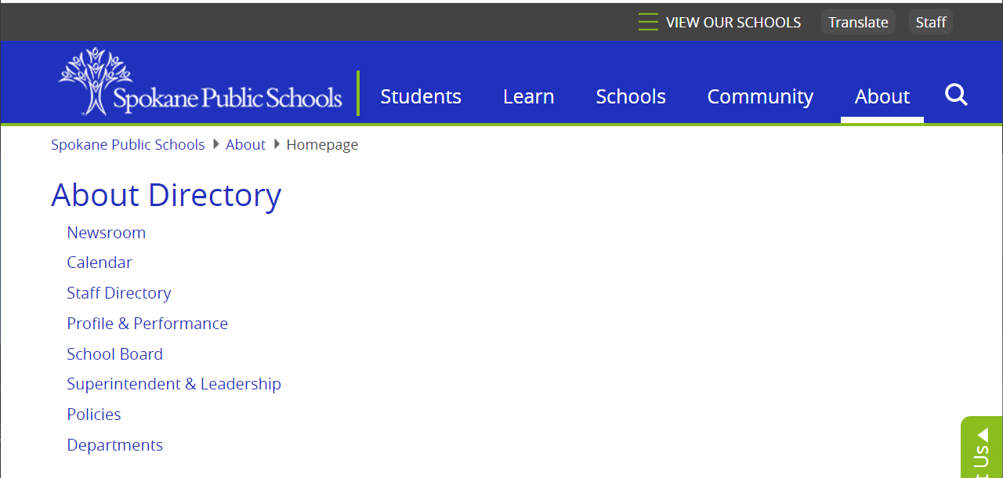
How to find District Policies:
Spokaneschools.org > About > Policies
District Policies Page

Slide 12

Who do I contact?
  The building administrator / principal or your supervisor
HIB
  Melanie Smith, Director of Student Services:
  (509) 354-7284
Title IV & Discrimination Officer:
  Jodi Harmon – (509) 354-7344
HR Employee/Labor Relations:
  Richelle Swartz, Director – (509) 354-5907
  Laura Sumner, Director – (509) 354-7285
  Jason Lesley, Manager – (509) 354-7262

Slide 13
SafeSchools Training
Safe Schools Training - Mandatory training for ALL employees within 30 days of employment.
  You will receive a link to your District email account annually (usually in September).​

Slide 14
L & I claims
All injuries must be reported.
All injuries are to be reported to supervisor and online incident report completed as soon as safely possible.
Complete the Incident Report online for ALL Injuries regardless if medical treatment is required or not.
  spokaneschools.org/staff - Forms → Safety & Risk Management → Online Incident/Injury Report
  Injury Report Page
Contact Tracy Adair (TracyA@spokaneschools.org) in Human Resources if you have any questions or concerns.

Slide 15
Payroll Information
Payday is the last working day of the Month.
The pay period begins on the 11th and goes through the 10th of the following month.
  Ex: Your October paycheck will reflect hours worked from September 11th through October 10th .
If the 11th falls on a weekend, the pay period does not start until the next working day.
Any payroll questions can be directed to the Shelly Sines at:
  Phone – 509 354-7230
  Email – michellesi@spokaneschools.org

Slide 16

I-1433 Sick Leave
One Hour for every 40 Hours Worked
Available balance is listed on your paystub in Employee Online.
When is it appropriate to use Sick Leave?
  You (the employee) are sick.
  Someone in your immediate family is sick and needs your care.
To use I-1433 sick leave, complete an exception form and return it to Shelly Sines at the time of absence.
Spokaneschools.org/staff - Forms> Payroll > Exception Hours Timesheets > General

Slide 17
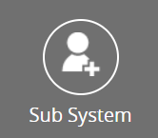

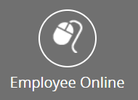
Technology
  FRONTLINE (formerly AESOP)
    This is used to accept jobs and record hours worked.
      Email - subdesk@spokaneschools.org
      Call - (509) 354-7343
  District E-mail
    Email is public record and is subject to review by court order, or public disclosure request:
      Do not use personal email for district/work related communication and do not use work email for personal use.
    Call Tech Services at 354-7600 for assistance.
  Employee Online (EO)
    This our payroll server.
    Access EO through the SPS Website.
    Your annual Letter of Assurance (LOA) will be sent to your Employee Online account.

Slide 18
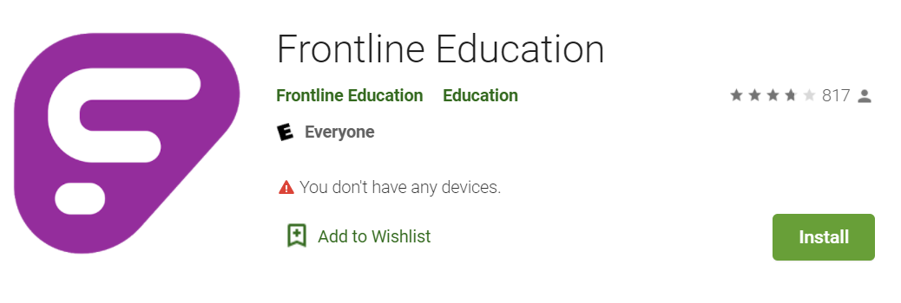
Frontline Mobile App
Download the Frontline Mobile App.
It’s FREE to Spokane Public School Employees.
You do not need a district code.
You need to set up your account via the web before you can
set up the mobile app.

Slide 19
Paraeducator Substitute Hourly Rates
  As of September 1, 2023
  Regular Para Jobs-
  $16.37448 per hour
    Resource Room
    Paraeducator Vacancies
  Para plus Diff –
  $19.48523 per hour
    BI
    DI
    CIP (Formerly MHOH)
    ABLE
    Transitions Programs
    Para plus diff Vacancies
    Student Paraeducator (one on one)
Notes:
CM
Direct deposit form
Web resource
School calendar resources

Slide 20
Special Education
Mission Statement:
Together we
Educate students with diverse needs through
Active engagement and
Meaningful relationships in inclusive environments.
Vision Statement:
Student persevere and self-advocate to reach their full potential

Slide 21
Steps to Determine
Special Education Services
How students qualify for SPED Services:
  Evaluated/Tested with parent permission.
What they may qualify for:
  Special Education Services
  Areas: Academics (reading, writing, math), Social/Behavior, and Adaptive.
  Related Services: SLP, OT, PT, Vision, Hearing.
How is Programming determined?
  Based on student needs.
Commonalities of Programs:
  Students may have health plans.
  All programs except Preschool and Transitional are K-21.

Slide 22
504’s, IEP’s & Medical Plans
What is a 504 plan and an IEP?
  A legal document with structures in place to meet the student’s educational needs.
What are medical plans?
  Medical plans are put in a place to safeguard students physical health issues.
    Example: students with diabetes, peanut allergies, and asthma.
  Medical plans MUST be followed in the interest of student safety.
Other services that substitutes should be aware of
  Various types of therapy from an OT, PT, SLP, Counselor, Math and/or Reading intervention.
    OT – Occupational Therapist
    PT – Physical Therapist
    SLP – Speech Language Pathologist

Slide 23
Program Types
Early Learning – Preschool
  Assist 3–5-year-old children with mild to severe disabilities to prepare for kindergarten or other elementary Special Education programs, including ECEAP.
  The preschool curriculum focuses on increasing cognitive, communication, social, behavior, adaptive, and motor skills.
  Preschool classrooms are generally staffed with 1 teacher, 2 paras and 12 students.
Resource Room
  Resource services provide specially designed instruction in reading, math, writing, and behavior/social skills and may be supported in the general education classroom and/or special education classroom.
  Students served in these programs experience disabilities such as health impairments, autism, learning disabilities, intellectual disabilities, and emotional behavior disorders.
  Resource classrooms are generally staffed with 1 teacher, 1-2 paras and 32 students.

Slide 24
Program Types
BI - Behavior Intervention
  Behavior Intervention Programs (BI) serve students who qualify for special education services or are 504 eligible who have emotional and behavioral difficulties.
  These students require intensive interventions related to social, and emotional behaviors in addition to academic support.
  BI classrooms are generally staffed with 1 teacher, 1.5 paras and 10 students.
DI – Designed Instruction
  Designed Instruction (DI) programs provide a self-contained classroom setting for students who have moderate to severe intellectual disabilities and delays in adaptive behavior.
  The curriculum focuses on functional skills in the following areas: communication, daily living, social and academics.
  Community access, vocational and transition skills are provided at the high school level.
  DI classrooms are generally staffed with 1 teacher, 2 paras and 10 students.

Slide 25
Program Types
CIP (Comprehensive Intervention Program – Formerly MHOH)
  CIP Programs serve students with severe to profound intellectual disabilities & significant physical impairments.
  These programs focus on functional communication, cognitive, and motor skill development. Students are involved in a wide variety of school programs and activities.
  CIP classrooms are generally staffed with 1 teacher, 2-3 paras and 8 students.
ABLE – Autism Behavior Learning Environment
  Autism Programs provide a continuum of supports to include behavior interventions, academic, social cognitive and communication skill development within the context of general classroom with occasional pullout.
  The program focus is teaching social skills, independence skills and emotional regulation skills within the context of general classroom with occasional pullout.
  ABLE classrooms are generally staffed with 1 teacher, 3 paras and 8 students.

Slide 26
Program Types - Transitions
These are designed to assist students with disabilities ages 19 through 21 in developing vocational and personal independence so that they will be successful upon graduation from high school. All three programs work closely with adult community agencies.
STEP Secondary Transition Education Program – Provides intensive supported services for access to instructional and vocational activities in the community supporting the final years of transition.
IMAGES program is located on the Spokane Community College campus and provides a community-based learning environment for students who have intellectual disabilities ages 19 through 21.
  Students enrolled in this program take PACE classes on campus and work independently as part of their educational program.
PROJECT SEARCH provides vocational opportunities immersed and integrated at Providence Sacred Heart Medical Center.
  This is a one-year transition program serving students in their final year. Students experience student internships in 2-3 vocational rotations.

Slide 27

Paraeducator Substitute What to Expect
“Classroom management is the wide variety of skills and techniques that teachers use to keep students organized, orderly, focused, attentive, on task, and academically productive during a class.”

Slide 28

Preparing for your Day
Know the start time of your assignment – double-check Frontline to ensure you are still assigned.
Know where you are going and pre-determine your route.
Dress appropriately
Follow the instructions provided and ask questions when necessary.
Have a positive can-do attitude.
Notes:
Find/save school numbers in your cell phone.

Slide 29

Work Schedule
High School 7:30 AM – 3:00 PM (11:15)
Elementary 8:00 AM – 3:30 PM (11:45)
Middle School 8:30 AM – 4:00 PM (12:15)
Late Start Mondays – only applies to students!
Arriving early is always advantageous.
Split assignments can be difficult.
Running Late? Call to alert the Office Manager or call the Sub Desk so we don’t worry about you!
MAKE SURE YOU ARE AWARE OF ITEMS ON THE
2023-24 SCHOOL CALENDAR.

Slide 30
Check in with the office
Report to the public office.
Sign in and introduce yourself to office staff and/or an Administrator.
Ask if there are any sub notes, or which class to report to.
Collect a Radio or Badge with access, if necessary.
Clarify cell phone usages rules for specific building.

Slide 31
Before School Starts
Go over lesson plan with teacher.
Ask teacher for any helpful information about your student if in a 1:1 situation.
Plan how you will build rapport with your student/class.
THINK
TREAT EVERY STUDENT WITH DIGINITY AND RESPECT!
Assume intelligence.
Fair vs Equal
Be ready to work as a TEAM MEMBER!
How would you want your child, grandchild, sibling, family member treated?
DO
Introduce yourself-be friendly.
Tell them who you are there for.
Ask them what their name is.
Meet them at their eye level.
Be aware of your body positioning and proximity.
Tell them what you are going to do.

Slide 32
Behavior Management & De-Escalation
Everything was going fine then…
Bit
Ran away
Hit
Scream
Ripped up work
Hurt themselves
Threw things
Disrobe
These behaviors often occur to get something or to avoid something.
Get:
  Attention
  Toy or Item
Escape:
  Work task
  Person

Slide 33
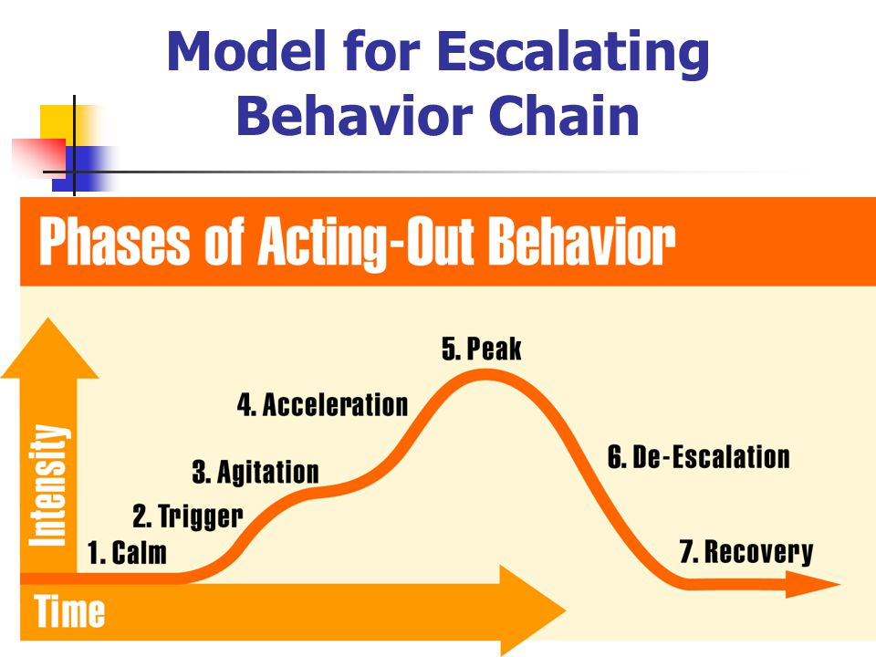
Escalation Cycle

Slide 34
De-escalating strategies
Stand at an angle to the student.
Do not invade their personal space.
Do not maintain a rigid stand or cause the student to feel cornered.
Do not touch the student.
Break eye contact with the student to reduce the suggestion of aggression or control.
Keep calm, neutral, and be confident.
Be an empathetic listener, do not “assume” what a student is thinking.
Display sincerity, don’t make threats, or set limits you cannot enforce.
Clarify communication and ask for specific responses.
Ignore challenges and comment only on student’s behaviors.
Keep language around “choices” followed by consequences (positive and negative).
Walk away for a minute, come back and re-engage.

Slide 35

DO NOT TOUCH KIDS!!

Slide 36
De-escalation strategies - for you
Remember you are the adult and can lead by example by showing a student how to handle big emotions
  Do breath-work together
  Do a time out together
  Do a redirection activity together
Do not touch students, no matter what
Recognize when you are going into “parent-mode”
Ask for help
Take a break
Switch tasks to redirect your brain

Slide 37

“The kids who need the most love will ask for it in the most unloving ways.”
-unknown

Slide 38
When to Contact the Office
If you feel your safety or the safety of any child is at risk, call the office immediately.
Other times to call the office:
  When a student has threatened you or another student or self.
  When the behavioral interventions you have in place and/or the de-escalating strategies were not successful.
  When the learning environment is seriously compromised.

Slide 39
End of School Day Items
Recap with the Teacher about the day.
Ask if there is any help needed closing the room for the day.
Return Radios and Badge with access to the Office Manager.
Sign out for the day.
Notes:
Add *SAMPLE NOTE*

Slide 40
Housekeeping
Lift Test – Must be completed prior to working in classrooms.
Minimum 10 days of subbing per year to remain a substitute.
Keep your contact information in Frontline up to date!
Resignation or new job
  Please send an email/letter advising us of your status change as soon as possible.

Slide 41
Final To Do List
We will only send email to your district email and not to your personal email.
Watch for an email from Frontline inviting you to set up your substitute account.
Please check your district email for Safe Schools Training for you to complete.
Remember we are all in this together.
  You are a critical team member!
  You will have an impact in any class you support!
  You make a difference in the lives of students!

Slide 42

There’s No Substitute for a Good Sub!
Thank you for being part of our team. We appreciate and value you, your time, and your talents!

